Slide 1
Arrays in Java
Prof. Kaustubh Kulkarni

Slide 2
Array
An array is a group of like-typed variables that are referred to by a common name.
Arrays of any type can be created and may have one or more dimensions.
A specific element in an array is accessed by its index.
Arrays offer a convenient means of grouping related information.
E.g. Student scores

Slide 3
One-Dimensional Arrays
A one-dimensional array is a list of like-typed variables.
To create an array, you first must create an array variable of the desired type.
The general form of a one-dimensional array declaration is
type[ ] var-name;
Here, type declares the element type (also called the base type) of the array.
For example, the following declares an array named month_days with the type “array of int”:
int[] month_days;

Slide 4
Allocation
Although the declaration on the previous slide establishes the fact that month_days is an array variable, no physical array actually exists.
new is a special operator that allocates memory.
The general form of new as it applies to one-dimensional arrays is as follows:
array-var = new type [size];
This example allocates a 12-element array of integers and links them to month_days:
month_days = new int[12];
It is possible to combine the declaration of the array variable with the allocation of the array itself:
int[] month_days = new int[12];

Slide 5
Accessing elements
The elements in the array allocated by new will automatically be initialized to zero (for numeric types).
Once you have allocated an array, you can access a specific element in the array by specifying its index within square brackets.
Array indices start at zero.
For example, this statement assigns the value 28 to the second element of month_days:
month_days[1] = 28;
The next line displays the value stored at index 3:
System.out.println(month_days[3]);

Slide 6
Array Initializer
Arrays can be initialized when they are declared.
An array initializer is a list of comma-separated expressions surrounded by curly braces.
The commas separate the values of the array elements.
The array will automatically be created large enough to hold the number of elements you specify in the array initializer.
There is no need to use new.

Slide 7
Example of array initializer
class AutoArray {
public static void main(String[] args) {
int[] month_days = { 31, 28, 31, 30, 31, 30, 31,31, 30, 31,30, 31 };
System.out.println("April has " + month_days[3] + " days.");
}
}

Slide 8
Another Example
// Average an array of values.
class Average {
public static void main(String[] args) {
double[] nums = {10.1, 11.2, 12.3, 13.4, 14.5};
double result = 0;
int i;
for(i=0; i<5; i++)
result = result + nums[i];
System.out.println("Average is " + result / 5);
}
}

Slide 9
Array Index Out of Bounds
Java strictly checks to make sure you do not accidentally try to store or reference values outside of the range of the array.
The Java run-time system will check that all array indexes are in the correct range.
For example, the run-time system will check the value of each index into month_days to make sure that it is between 0 and 11 inclusive.
If you try to access elements outside the range of the array (negative numbers or numbers greater than the length of the array), you will cause a run-time error.

Slide 10
Multidimensional Arrays
In Java, multidimensional arrays are implemented as arrays of arrays.
To declare a multidimensional array variable, specify each additional index using another set of square brackets.
For example, the following declares a two-dimensional array variable called twoD:
int[][] twoD = new int[4][5];
This allocates a 4 by 5 matrix and assigns it to twoD.
Internally, this matrix is implemented as an array of arrays of int.
Conceptually, this array will look like the one shown in the next slide.

Slide 11
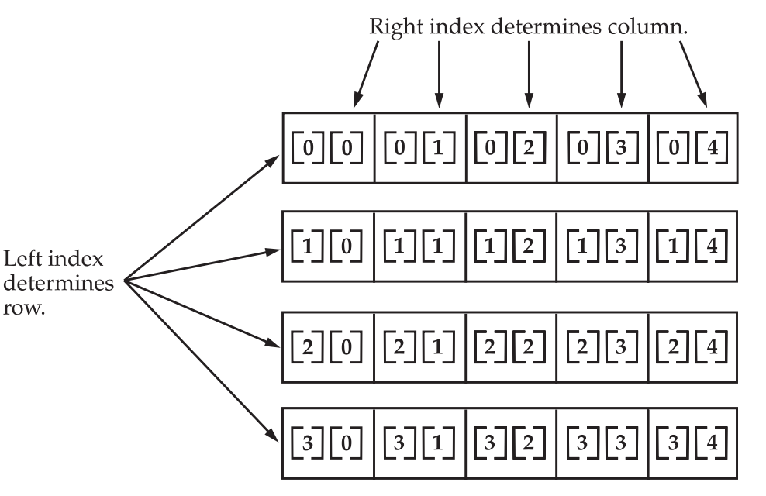
A conceptual view of a 2D array

Slide 12
2D array example
class TwoDArray {
public static void main(String[] args) {
int[][] twoD= new int[4][5];
int i, j, k = 0;
for(i=0; i<4; i++)
for(j=0; j<5; j++) {
twoD[i][j] = k;
k++;
}
for(i=0; i<4; i++) {
for(j=0; j<5; j++)
System.out.print(twoD[i][j] + " ");
System.out.println();
}
}
}

Slide 13
int[][] twoD= new int[4][5];
is equivalent to:
int[][] twoD = new int[4][];
twoD[0] = new int[5];
twoD[1] = new int[5];
twoD[2] = new int[5];
twoD[3] = new int[5];

Slide 14
Irregular Array
When you allocate memory for a multidimensional array, you need only specify the memory for the first (leftmost) dimension.
You can allocate the remaining dimensions separately.
As stated earlier, since multidimensional arrays are actually arrays of arrays, the length of each array is under your control.
Each “row” (1st dimension) can have different number of “columns” (2nd dimension)
AKA Jagged Array

Slide 15
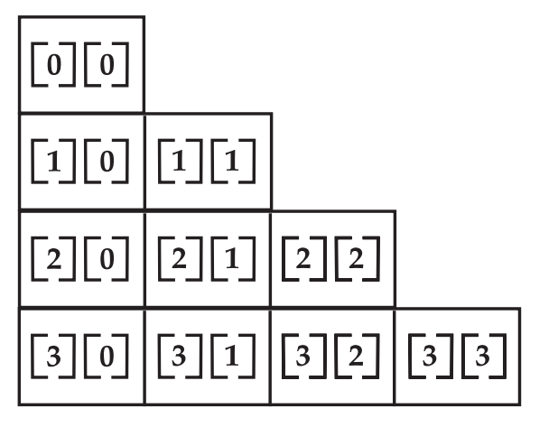
Example of a Jagged Array
int[][] twoD = new int[4][];
twoD[0] = new int[1];
twoD[1] = new int[2];
twoD[2] = new int[3];
twoD[3] = new int[4];

Slide 16
// Manually allocate differing size second dimensions.
class TwoDAgain {
public static void main(String[] args) {
int[][] twoD = new int[4][];
twoD[0] = new int[1];
twoD[1] = new int[2];
twoD[2] = new int[3];
twoD[3] = new int[4];
int i, j, k = 0;
for(i=0; i<4; i++)
for(j=0; j<i+1; j++) {
twoD[i][j] = k;
k++;
}
for(i=0; i<4; i++) {
for(j=0; j<i+1; j++)
System.out.print(twoD[i][j] + " ");
System.out.println();
}
}
}

Slide 17
When to use
Irregular arrays can be used effectively in some situations.
For example, if you need a very large two-dimensional array that is sparsely populated (that is, one in which not all of the elements will be used), then an irregular array might be a perfect solution.

Slide 18
Initializing multidimensional arrays
Simply enclose each dimension’s initializer within its own set of curly braces.
double[][] m = {
{ 0*0, 1*0, 2*0, 3*0 },
{ 0*1, 1*1, 2*1, 3*1 },
{ 0*2, 1*2, 2*2, 3*2 },
{ 0*3, 1*3, 2*3, 3*3 }
};
It creates a matrix where each element contains the product of the row and column indexes.
Also notice that you can use expressions as well as literal values inside of array initializers.

Slide 19
Alternative Array Declaration Syntax
There is a second form that may be used to declare an array:
type var-name[ ];
Here, the square brackets follow the array variable name, and not the type specifier.
For example, the following two declarations are equivalent:
int a1[] = new int[3];
int[] a2 = new int[3];
The following declarations are also equivalent:
char twod1[][] = new char[3][4];
char[][] twod2 = new char[3][4];
This alternative declaration form offers convenience when converting code from C/C++ to Java.
It also lets you declare both array and non-array variables in a single declaration statement.

Slide 20
Using arraycopy( )
The arraycopy( ) method can be used to copy quickly an array of any type from one place to another.
This is much faster than the equivalent loop written out longhand in Java.
Here is an example of two arrays being copied by the arraycopy( ) method.
First, a is copied to b.
Next, all of a’s elements are shifted down by one.
Then, b is shifted up by one.

Slide 21
Using arraycopy( )
Use System's arraycopy() method to efficiently copy data from one array into another.
The arraycopy() method requires five arguments:
public static
void arraycopy(Object source,
int srcIndex,
Object dest,
int destIndex,
int length,
The two Object arguments indicate the array to copy from and the array to copy to.
The three integer arguments indicate the starting location in each the source and the destination array, and the number of elements to copy.

Slide 22
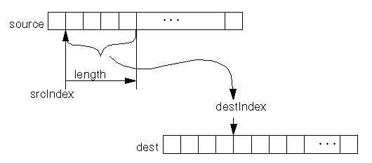
Illustration of arraycopy()

Slide 23
class ArrayCopyTest {
public static void main(String[] args) {
byte[] copyFrom = { 'd', 'e', 'c', 'a', 'f', 'f', 'e', 'i', 'n', 'a', 't', 'e', 'd' };
byte[] copyTo = new byte[7];
System.arraycopy(copyFrom, 2, copyTo, 0, 7);
System.out.println(new String(copyTo, 0));
}
}

